Slide 1
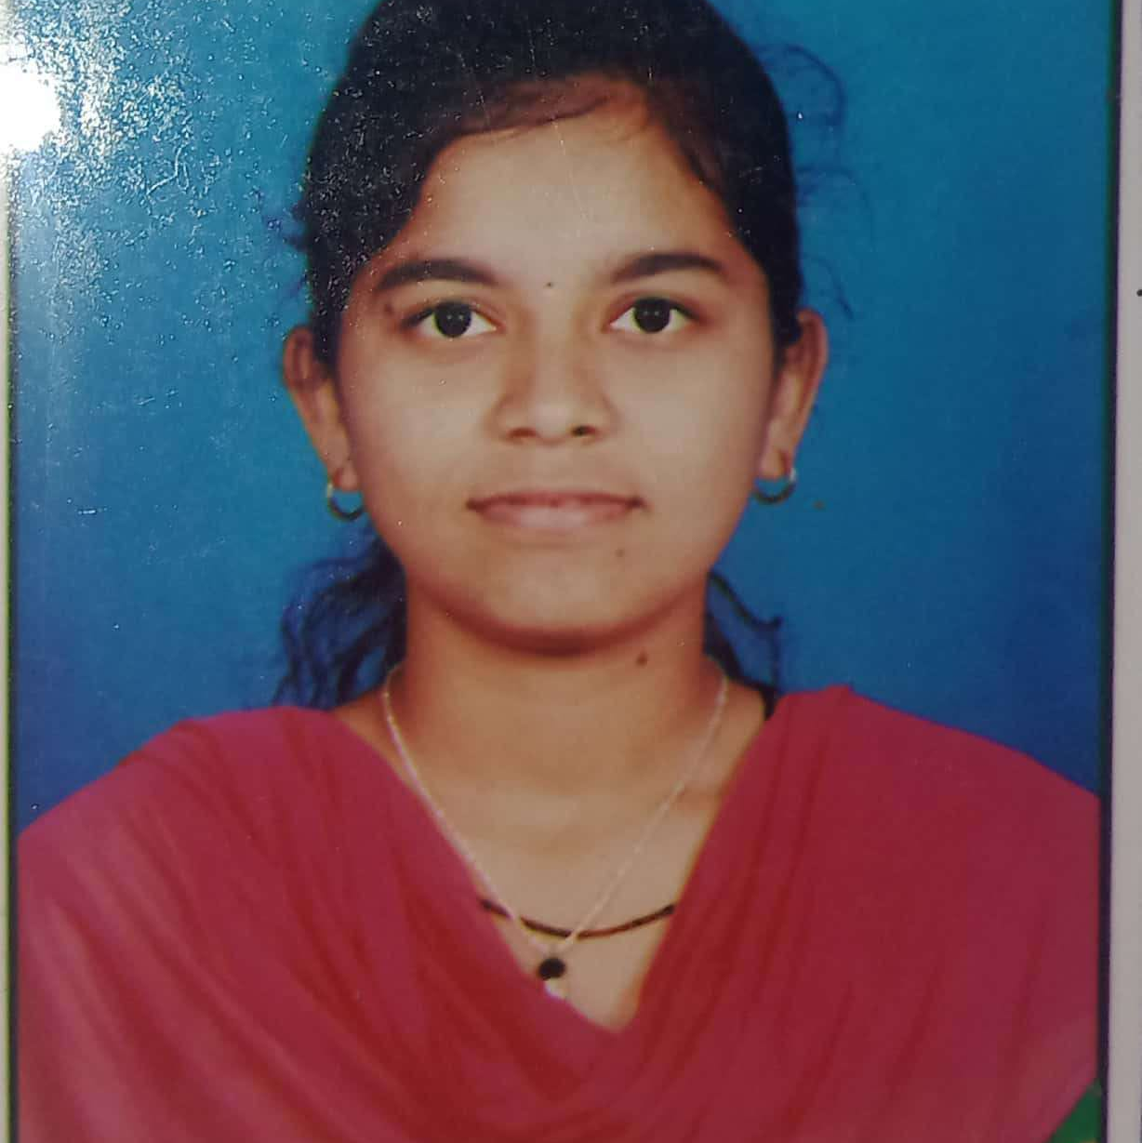


Nayan Ajaykumar Inamdar
Analyst/Software Engineer
Bachelor of Technology
Electrical Engineering :2017-2021
Skills
Java 8 /J2EE | Java Basics, OOPS, Generics, Collections, Arrays, Loops, Lambda Exp, Stream API Junit, Mockito, Servlets
Spring core | IOC & Dependency Injection, Autowire
Spring REST | REST controllers, Implementation of GET, POST, PUT & DELETE, Bean Validation & Exception Handling, Testing Services, Controller & Repository layer
Spring Data JPA | Implement DAO layer using spring Data repositories, Transaction Management
Spring Boot Microservices | Spring Boot Starters, annotations, Messaging Service, Sync/Async comms, Swagger API documents
Spring Cloud | Eureka, Netflix Ribbon, Feign Client, Netflix Hystrix, Netflix Zuul & Config Server
Angular | Components, Services, Modules, Routing, Forms & Validation, Testing using Jasmine & Karma
Database | MongoDB No Sql Basics My SQL RDS Basics
UI Tech | HTML 5 & CSS 3,JavaScript, ES6 & TypeScript Reusable templates, Optimized UI Designed
Tools | Git, Postman, Maven, Eclips
Add On skills | Communications, Team management. Peer learning
Mumbai
NAYAN-AJAYKUAMR-IANMADRA@capgemini.com
+91 9067802642
A4
Full Stack Developer
Hands on experience in creating microservices with Springboot, Spring Security, Spring Cloud API Gateway, Eureka server, load balancing,zipkin
Proficient in creating Single page Web Application in Angular with Authentication with route guards, Angular reactive forms, angular routing, Tailwind CSS
Hands on experience in implementing with NodeJs & spring boot
Experience in creating documentation with Java docs and swagger and in unit testing using Junit, Mockito including code quality compliance using Sonar cube
Development experience in creating docker images and pushing to Docker Hub with containerized applications using Docker SWARM
In-depth understanding of deploying spring boot applications
Flight Booking Application System
Completed end to end case study of flight booking Application along with JWT authentication, Swagger and payment testing using Stripe, responsive UI with Tailwind CSS and Angular used for user interface.
MCQ Application https://pgexam-app.herokuapp.com/
Developed MCQ application named Waddy for NEET PG students to practice mock tests using AngularJs, NodeJs ExpressJs, JWT, MongoDB, Heroku website
Completed ”Applied Data Science with Python specialization“ course at Coursera
Check out my work on GitHub & Video Profile

